Slide 1
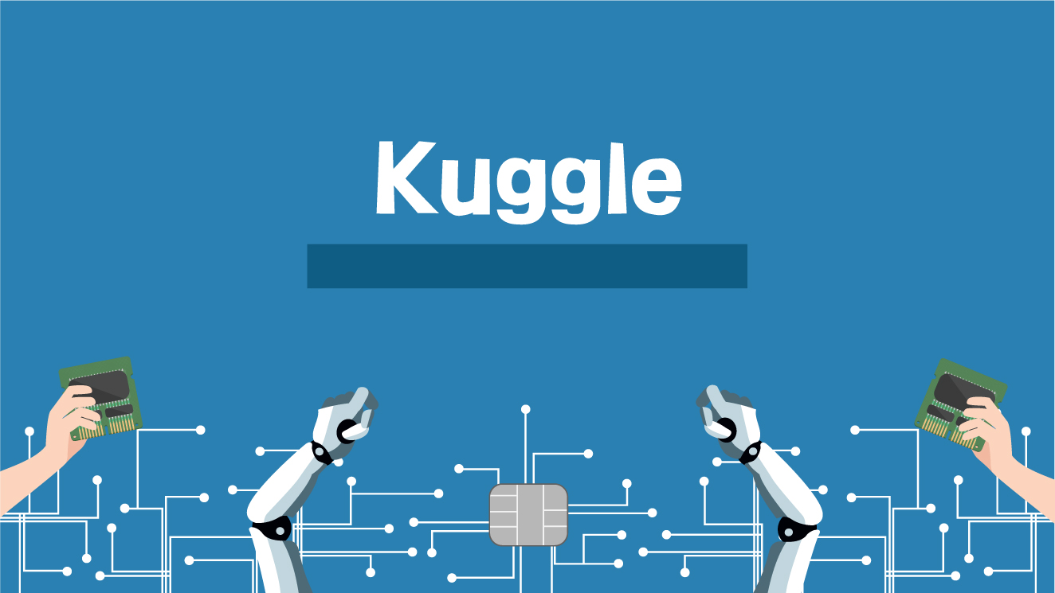
2020_02 Kuggle 정규세션_W5
2020.10.06

Slide 2
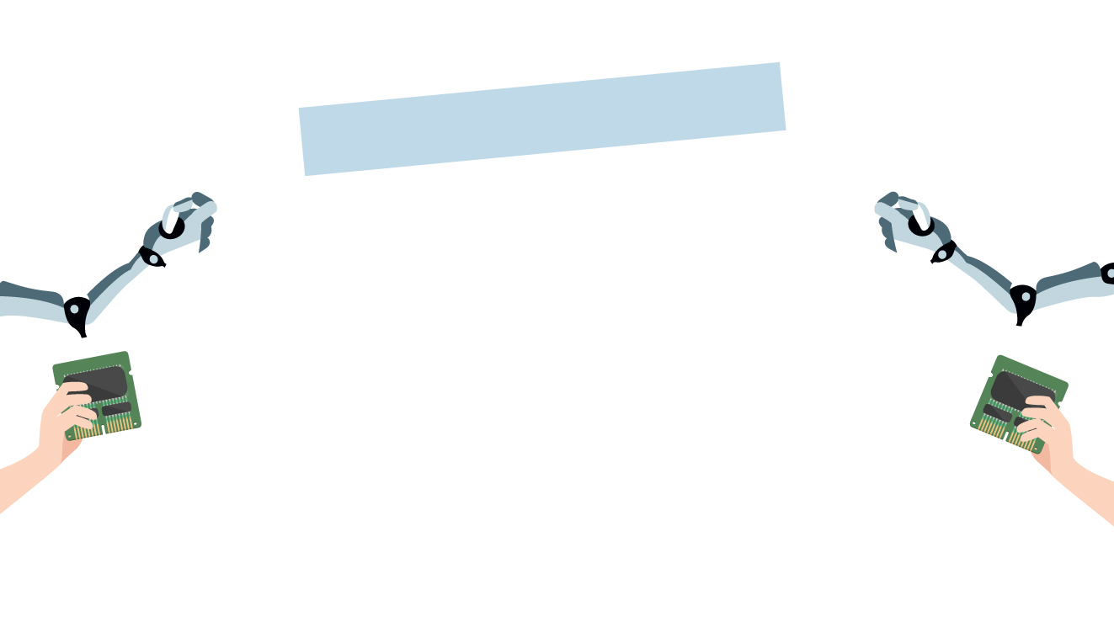
Decision Tree
엔트로피 / Information Gain
Attributes with ‘ ‘
1
2

Slide 3
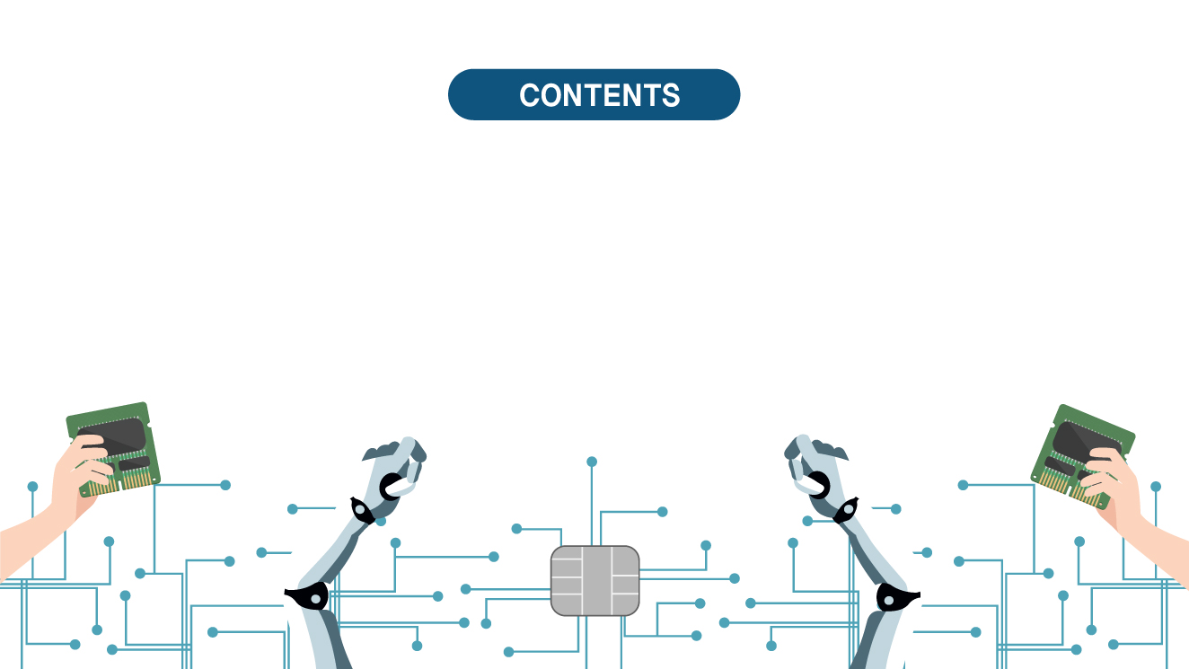
01
02
Entropy & Information Gain
Attributes with ‘ ‘
Decision Tree
Entropy
Information Gain
Examples
Continuous value
Many values
Costs
Model 장단점

Slide 4

01. Entropy & Information Gain
Decision Tree
Entropy
Information Gain
Examples

Slide 5
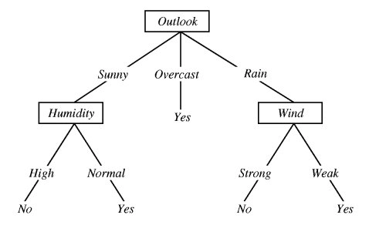
Decision Tree
자질들의 정보 획득량(Information Gain)에 따라 트리 형태의 규칙을 자동 생성하는 기계학습 모델

Slide 6
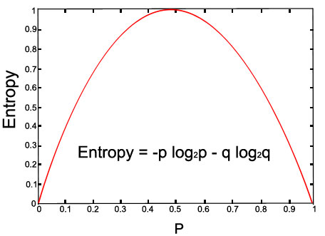
엔트로피(Entropy)
S는 training examples의 sample
p⊕는 S의 양성 비율, p⊖는 음성 비율
Entropy measures the impurity of S
Entropy(S)
= -p⊕log2(p⊕) – p⊖log2(p⊖)

Slide 7
엔트로피(Entropy)
Entropy(S)
= expected number of bits needed to encode class (⊕ or ⊖) of randomly drawn member of S (under the optimal, shortest-length code)
Why?
Information theory: optimal length code assigns –log2(p) bits to message having probability p.
So, expected number of bits to encode ⊕ or ⊖ of random member of S:
p⊕(-log2(p⊕)) + p⊖(-log2(p⊖)) ∴Entropy(S) = -p⊕log2(p⊕) – p⊖log2(p⊖)

Slide 8
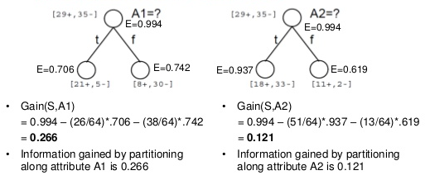
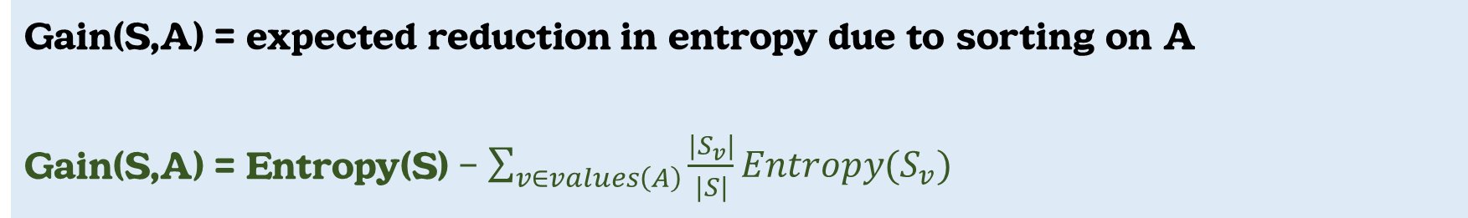
Information Gain
: 자질의 값을 알게 됨으로써 얻어지는 문제 복잡도(전체 엔트로피)에 대한 감소 기대치
Gain(S,A) = expected reduction in entropy due to sorting on A
Gain(S,A) = Entropy(S) – $\sum_{v∈values\left(A\right)}{\frac{\left|S_{v}\right|}{\left|S\right|}}Entropy(S_{v})$

Slide 9
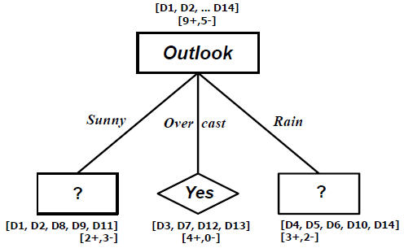
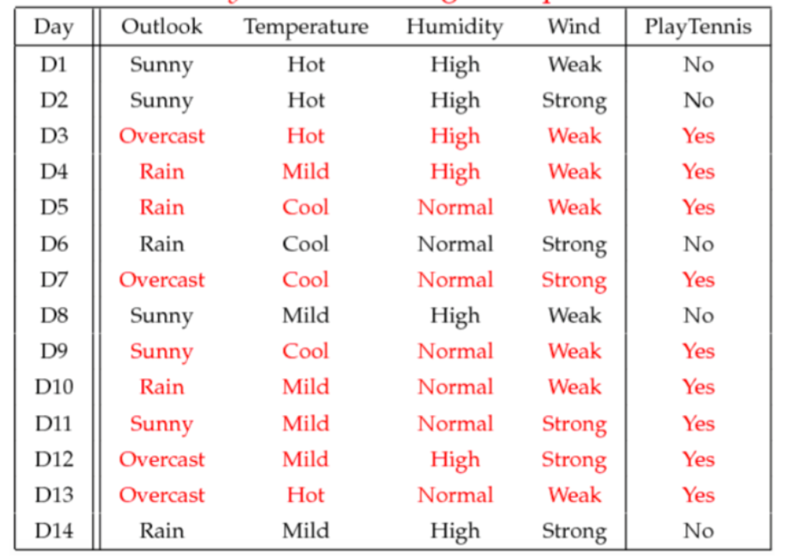
Training Examples (1) 첫번째 노드 결정
S = [9+, 5-]
S_weak = [6+, 2-]
S_strong = [3+, 3-]
IG(S,Wind) = Entropy(S) – 8/14*Entropy(S_weak) – 6/14*Entropy(S_strong)
= 0.94 – 8/14*0.811 – 6/14*1.00
= 0.048
IG(S,Outlook) = 0.246
IG(S,Humidity) = 0.151
IG(S,Temperature) = 0.029
Root Node = ‘Outlook’

Slide 10
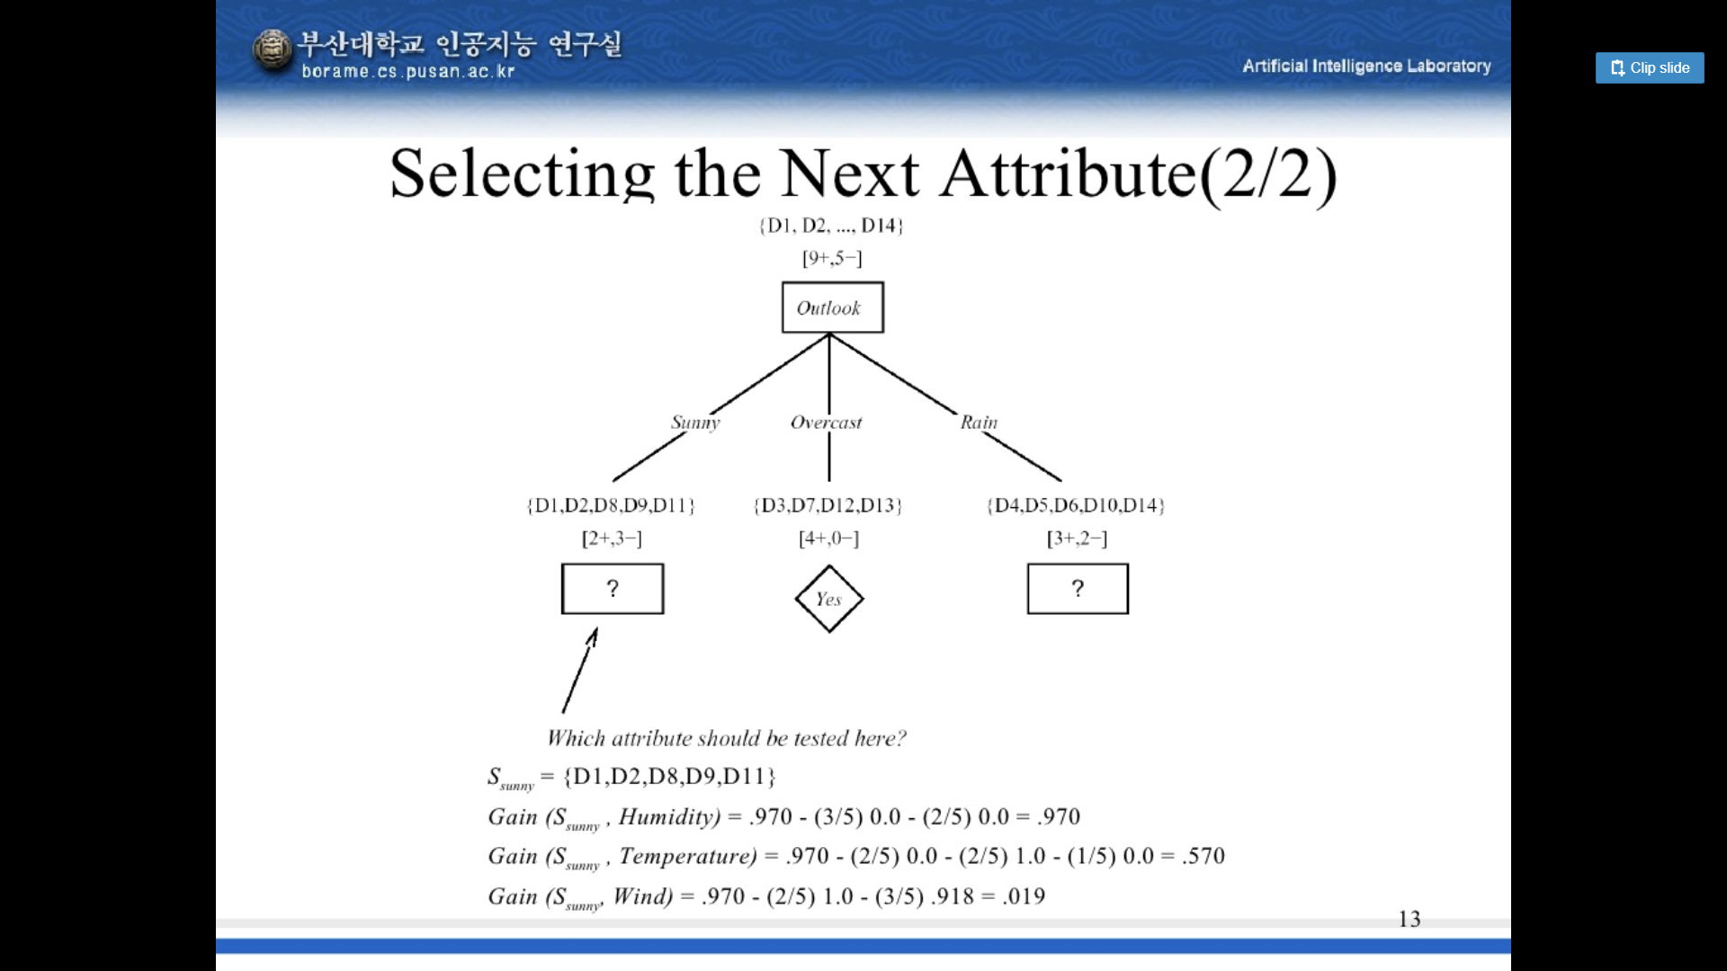
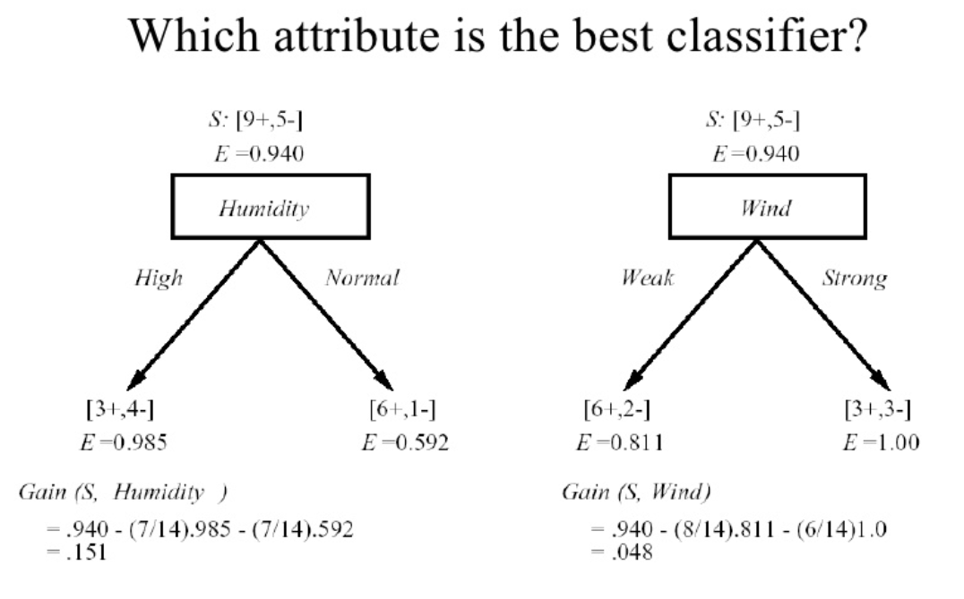
Training Examples (2) 다음 노드 결정
S_sunny = {D1,D2,D8,D9,D11}
Gain(S_sunny,Humidity) = 0.97 – 3/5*0– 2/5*0
= 0.97
Gain(S_sunny,Temperature) = 0.97 – 2/5*0 – 2/5*1 – 1/5*0 = 0.57
Gain(S_sunny,Wind) = 0.97 – 2/5*1 – 3/5*0.918 = 0.019

Slide 11
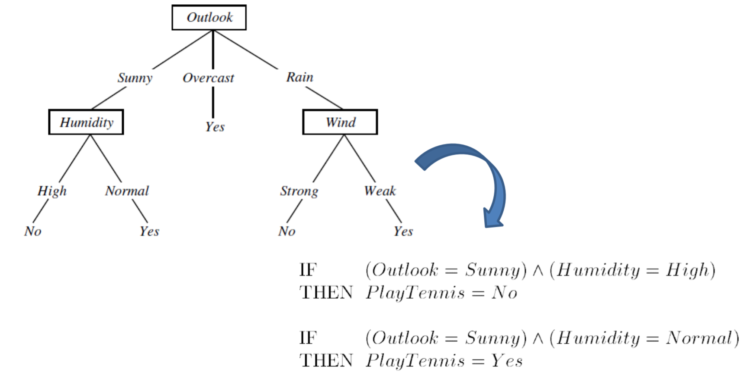

Slide 12
02. Attributes with ‘ ‘
Continuous valued attributes
Many Values
Costs
Model 장단점

Slide 13
Continuous Valued Attributes
Create a discrete attribute to test continuous
Temperature = 82.5
(Temperature > 72.3) = T, F
Temperature: 40 48 60 72 80 90
PlayTennis: No No Yes Yes Yes No

Slide 14
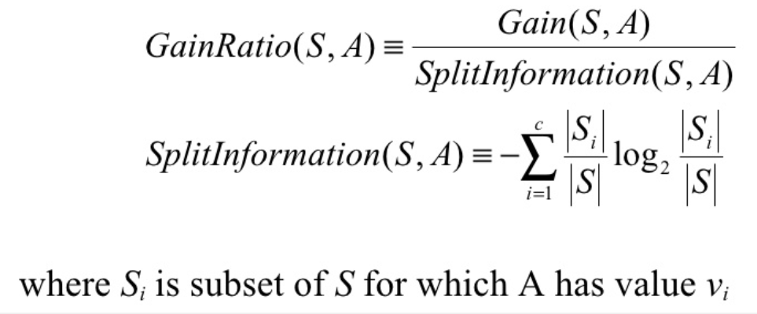
Attributes with Many Values
Problem:
- 속성값이 많다면, Gain은 그 속성을 선택
- Date = Jun_3_1996이 속성이라고 상상해봐요
One approach: use GainRatio instead

Slide 15
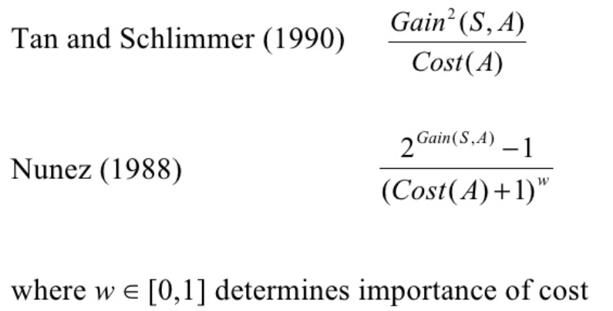
Attributes with Costs
Consider:
- 의학 진단, BloodTest는 $150의 비용이
- 로봇학, Width_from_1ft 는 23초의 비용이 사용됨
A consistent Tree가 low expected cost로 학습하게 하는 방법은?
One approach: replace gain by

Slide 16
Advantages and Disadvantages
Advantages
Does feature selection
Handles features of different types
Very fast prediction
Interpretable decision rules
Disadvantages
Does not combine feature values, difficulty with dependent features
Finding optimal trees is intractable
Implement
- C4.5: Free -CART: Commercial

Slide 17
Playtennis 데이터를 이용하여 Decision Tree 분류기 만들기

Slide 18
과제
(1) 여기에 들어갈 자질이 무엇인지 hand simulation 하여 결정하세요.
(2) IRIS 데이터를 이용하여 Decision Tree 분류기 만들기
+ Accuracy 이용하여 Decision Tree 평가

Slide 19
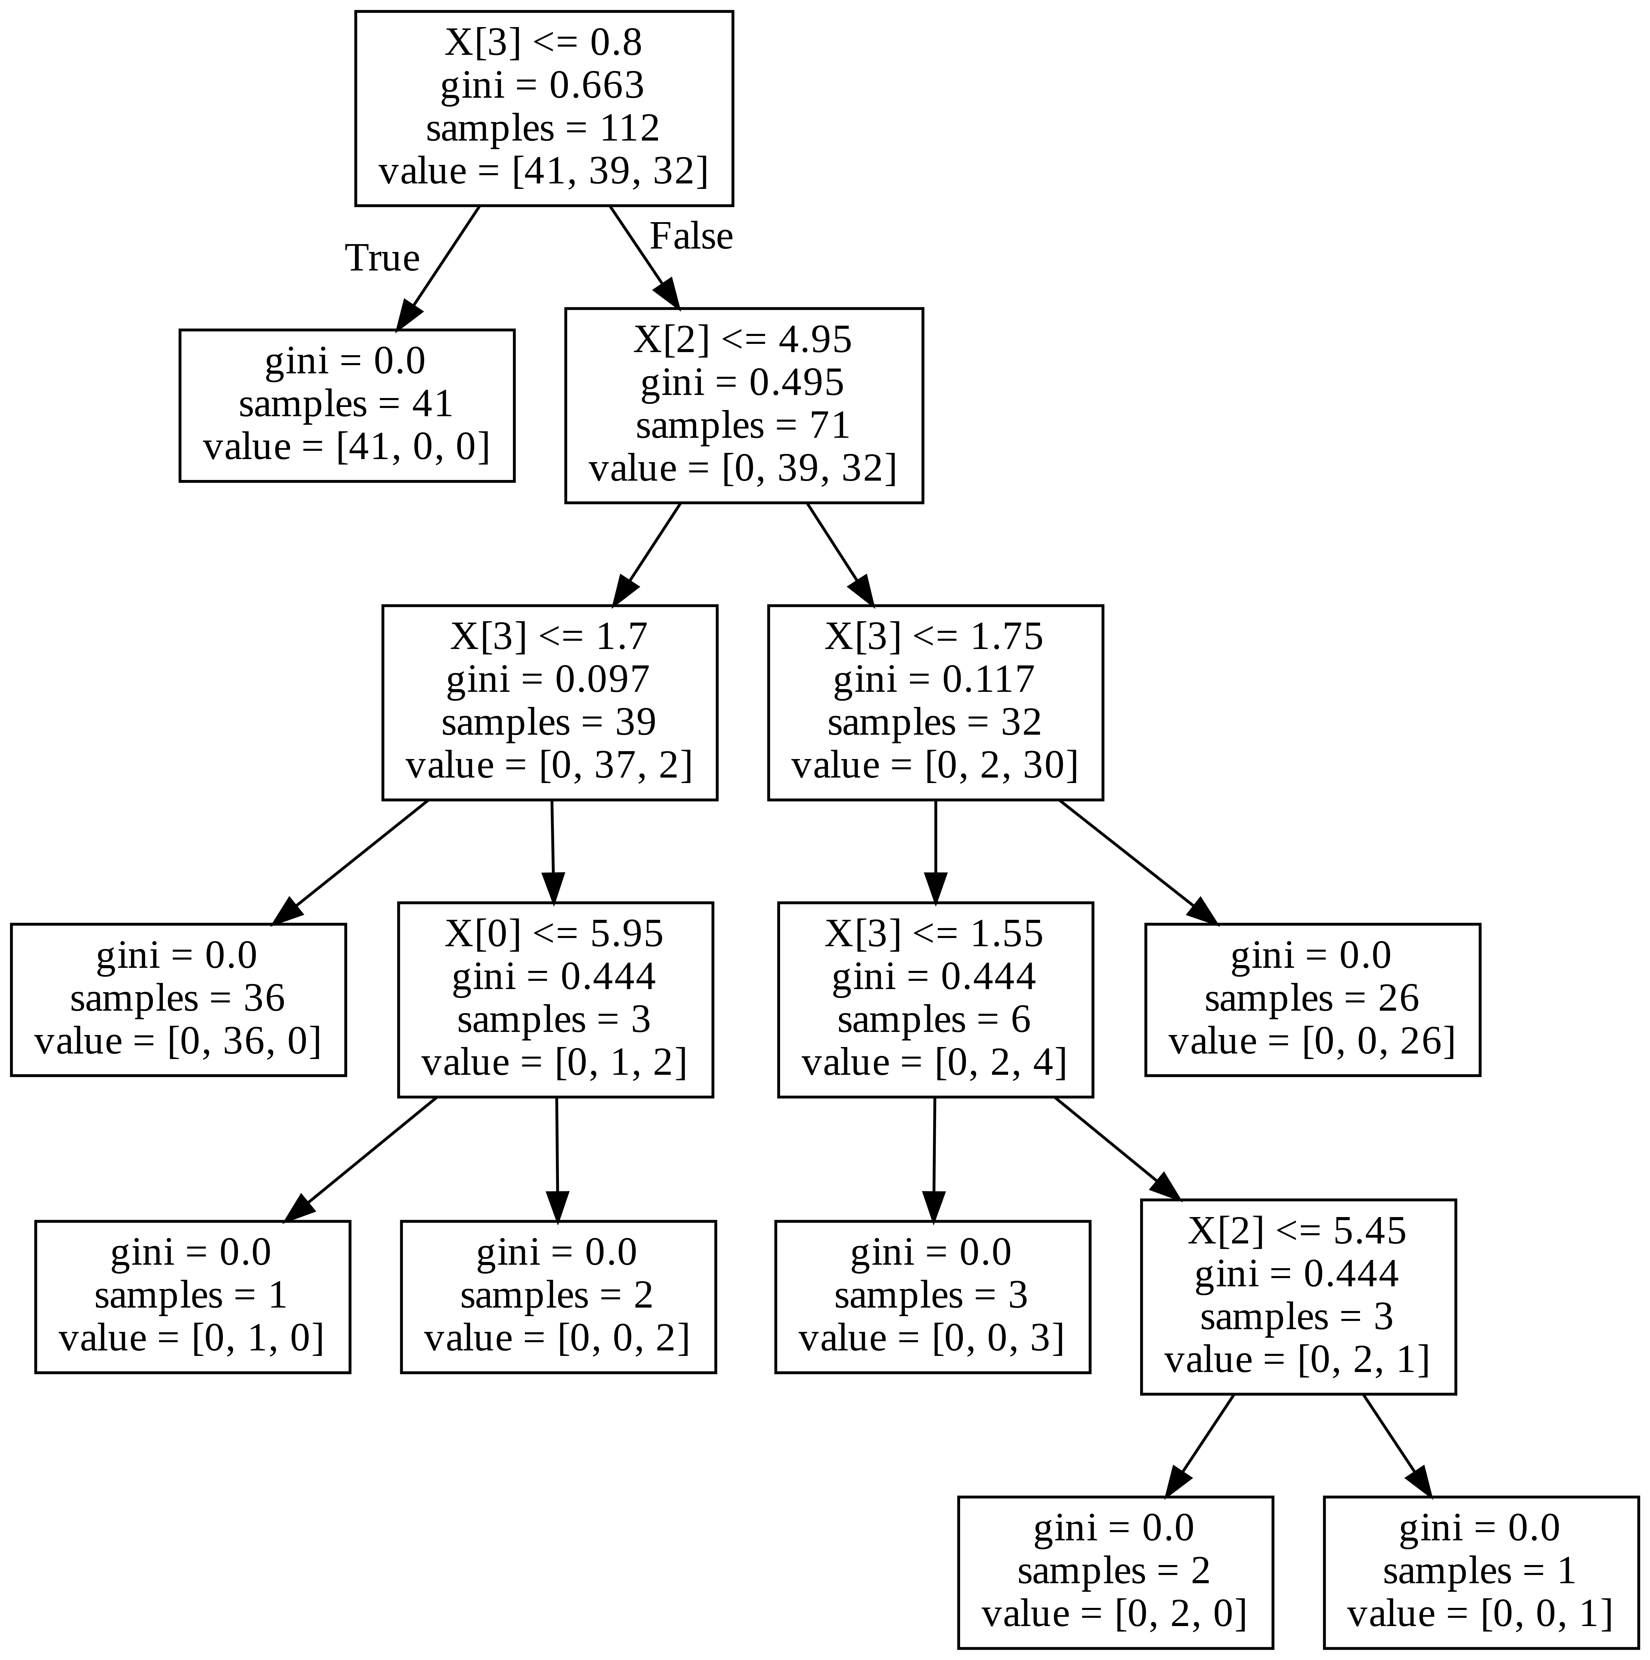
DecisionTreeClassifier( )
DecisionTreeClassifier(ccp_alpha=0.0, class_weight=None, criterion='gini’, max_depth=None, max_features=None, max_leaf_nodes=None, min_impurity_decrease=0.0, min_impurity_split=None, min_samples_leaf=1, min_samples_split=2, min_weight_fraction_leaf=0.0, presort='deprecated’, random_state=None, splitter='best’)
gini 계수: 불순도를 의미하며, 엔트로피와 비례

Slide 20


